Slide 1

Predicting Diamond Prices
Sindy Saintclair

Slide 2



Exploring…
Variables by which we will predict the price of diamonds
Train Test Split
Linear Regression Model
Examining Predictions and Accuracy Scores
Creating kFolds and Cross-Validation

Slide 3




Introduction
In this PowerPoint, we will be taking data, cleaning the data so that its usable, and creating a linear model to predict the price of the diamonds according to the diamond’s clarity, color, carat, and cut using Python.

Slide 4
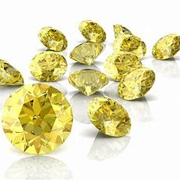

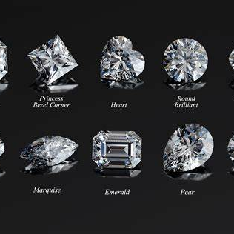
Independent Variables
We are asked to predict the price of diamonds according to one continuous variable (carats) and three other categorical variables (color, clarity, and cut).
To do this, we must recode the categorical variables into continuous data before carrying on with our data analysis.

Slide 5
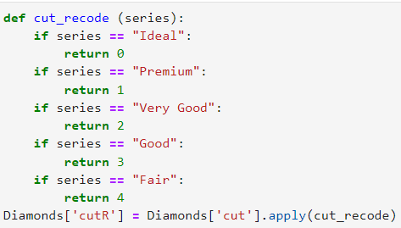
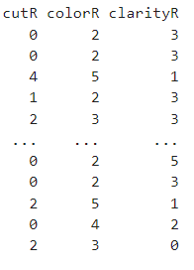
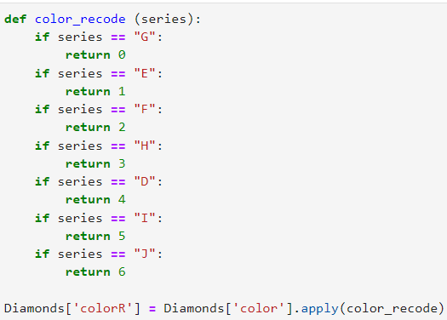
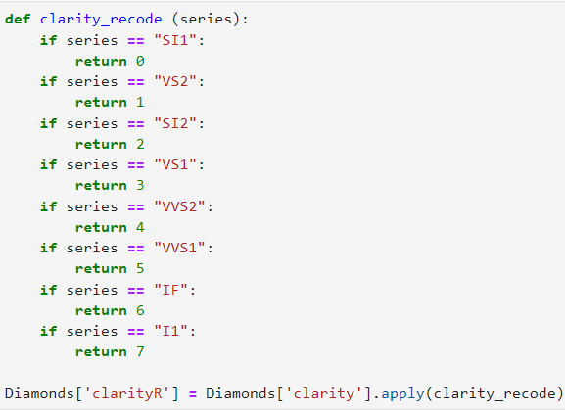
Recoding Categorical Variables Color, Cut, and Clarity
This is the process that was taken in order to recode the categorical independent variables that we have to come to know as cut, color, and clarity—leaving out only carat as it is measured numerically thus making it continuous data.
This should make creating a Linear Regression model much easier to better analyze and predict the price of the diamond.
To be sure, we will also check the errors and accuracy of the linear model made to ensure that this if of course is a credible and usable model.

Slide 6

Using the Train Test Split Method
Sindy Saintclair

Slide 7
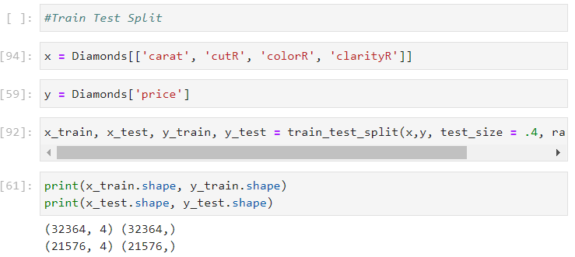

Steps
Identify x and y variables for the train test split method. X in this case would be the independent variables we mentioned before: carat, cut, clarity, and color. And y would be the dependent variable or predictor, the price.
Next, we finally carry out the train test split method in which we discover that there are 4 columns and 32,364 rows for the x_train dataset and 21,576 rows and 4 columns for the x_test dataset.

Slide 8
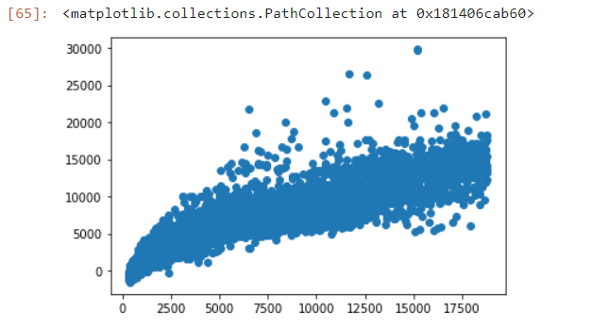
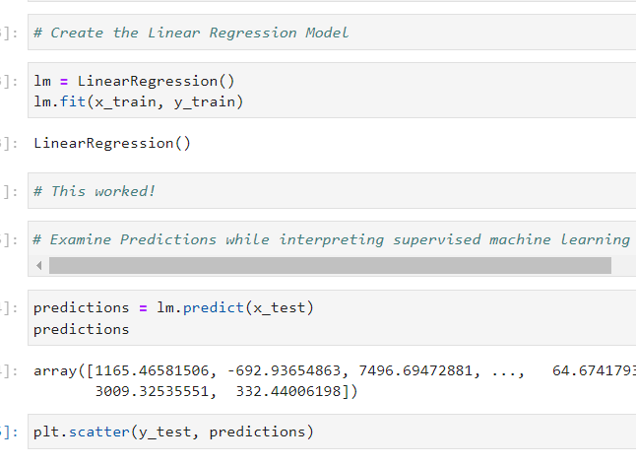
Creating the Linear Model
In the image to the right, is the process involved in creating the linear regression model and examining predictions via scatterplot creation.
The image above shows the scatterplot of the y_test and predictions made.

Slide 9

Scatterplot Analysis
It is best to know that the straighter the line of the linear regression model, the more accurate it is. According to the scatterplot, the line looks straight for the most part, except for a few outliers here and there.
To quantify the accuracy, one can use this code:
According to this calculation, the accuracy of the scatterplot is approximately 86.64%, which is rather high in the real-world.

Slide 10
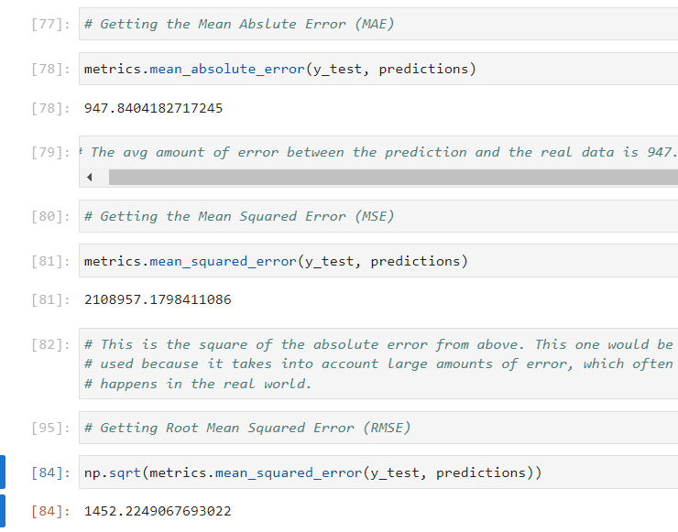
Acquiring the Different Errors: MAE, MSE, & RMSE
This shows the process involved in acquiring the mean absolute error(MAE), the mean squared error(MSE), and the root mean squared error(RMSE).
According to Python programming, the MAE was found to be 947, which is quite high. The MSE was 2,108,957, which is MAE squared and the RMSE is 1452. The closer to zero the RMSE, the better the model fits. As you can see, there must be better models than this one to fit the Diamond data.

Slide 11

Explaining MSE, RMSE, and MAE
MSE considers large amounts of error, which often happens in the real world. MAE is the average amount of error between the prediction and the real data. RMSE is the most popular.

Slide 12

But is that instance of train-test-split enough?
This is why we have K-Folds. The idea behind k-folds cross-validation is that you don’t want to rely on just one iteration of train-test-split, because it could be biased accidentally.

Slide 13

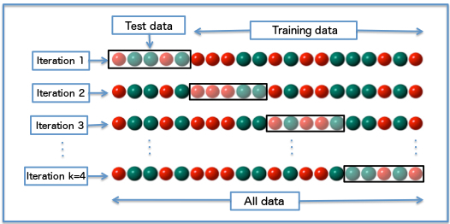
k-folds cross validation method
Here is a visual of the k-folds cross-validation method, using four iterations. Iterations 1-3 each have a different testing set and use the rest of the data for training. In the fourth iteration, all the data available is used. This function:
Randomizes the data
Splits the data into groups (k#)
For each group, creates a test set and a training set, then fits a model and retains the accuracy score

Slide 14
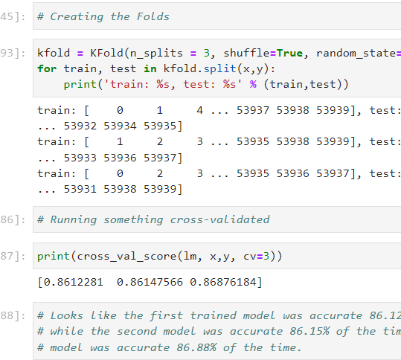
Creating the Folds & Running Cross-Validation
It appears the first trained model was accurate 86.12% of the time, while the second model was accurate 86.15% of the time, and the third model was accurate 86.88% of the time.
This would corroborate initial findings that the accuracy of this linear model is quite high given what normally occurs the real world.

Slide 15

Summary
In summation, though the linear model is highly accurate, the MAE, MSE, and RMSE, show that it may not be the best fit for the data, given that all errors gave numbers far from 0. However, on a scale of 0 to infinity, this isn’t too bad.

Slide 16


Thank You
Presenter name
Email address
Website address

